Slide 1
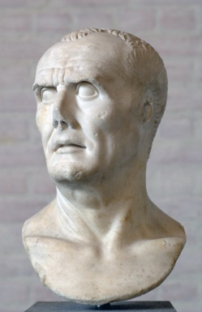
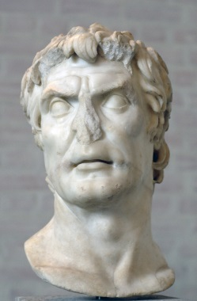
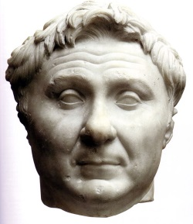
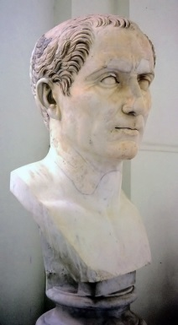
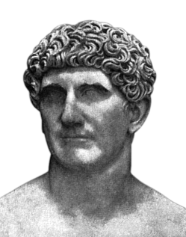
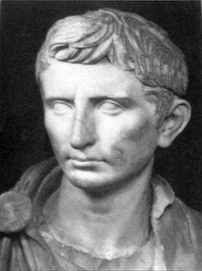
Civil Wars
Marius
Sulla
Pompey
Julius Caesar
Mark Antony
Octavian

Slide 2
Sources
Contemporary
Later (but still ancient)
Caesar himself
Gallic Wars
Civil War
Cicero
Letters
Suetonius
Life of Caesar
Plutarch
Life of Caesar
Appian
Civil Wars
Cassius Dio

Slide 3

Julius Caesar
Gaius Julius Caesar
c. 100-44 BCE
From the patrician Julian family
Nephew of Marius
Quaestor in 69, elected Pontifex Maximus in 63
Became consul in 59 with the support of Pompey and Crassus

Slide 4
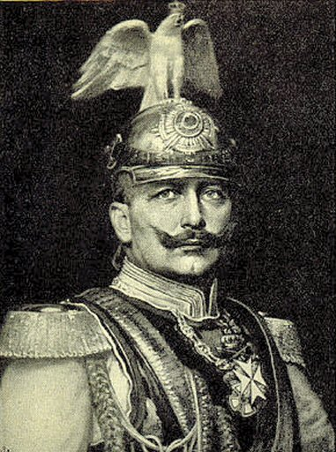
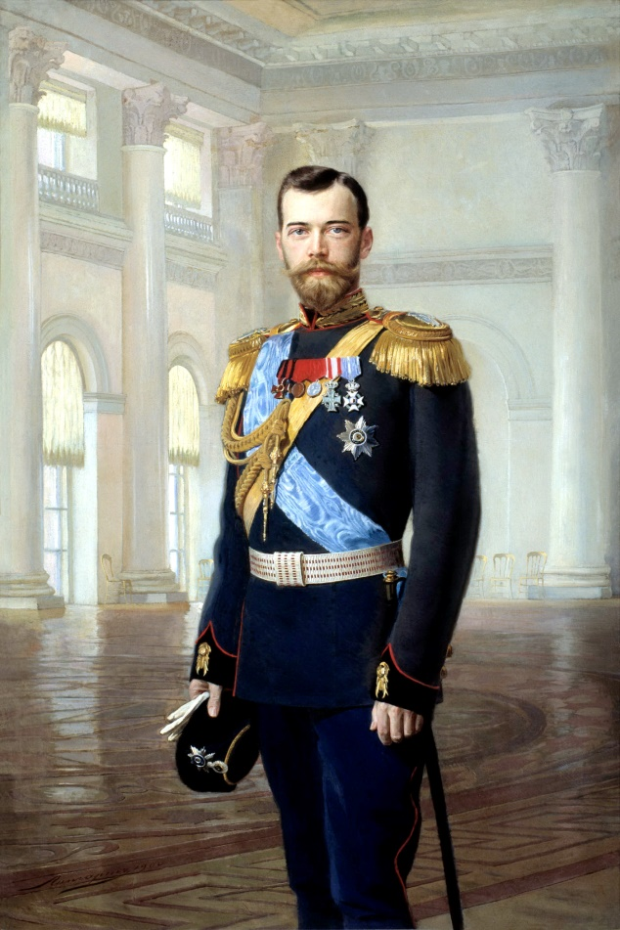
Later ‘Caesars’
Kaiser
Czar/Tsar
Kaiser Wilhelm II (r. 1888-1918)
Tsar Nicholas II (r. 1894-1918)

Slide 5
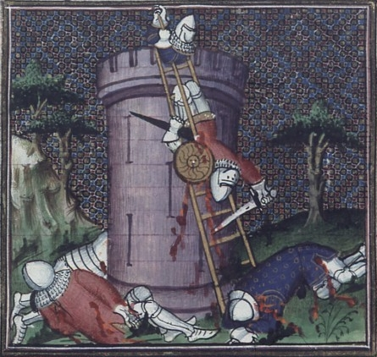
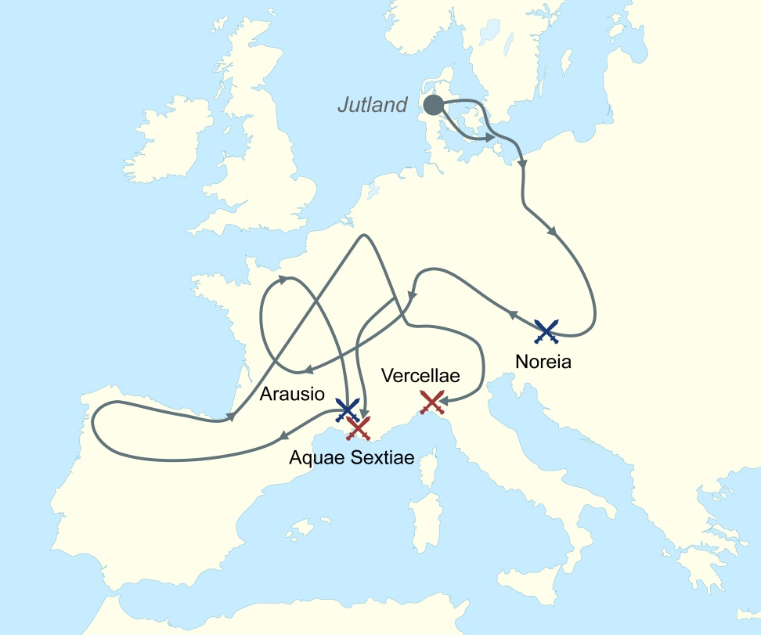
The Gauls
390 BCE
104-101 BCE

Slide 6
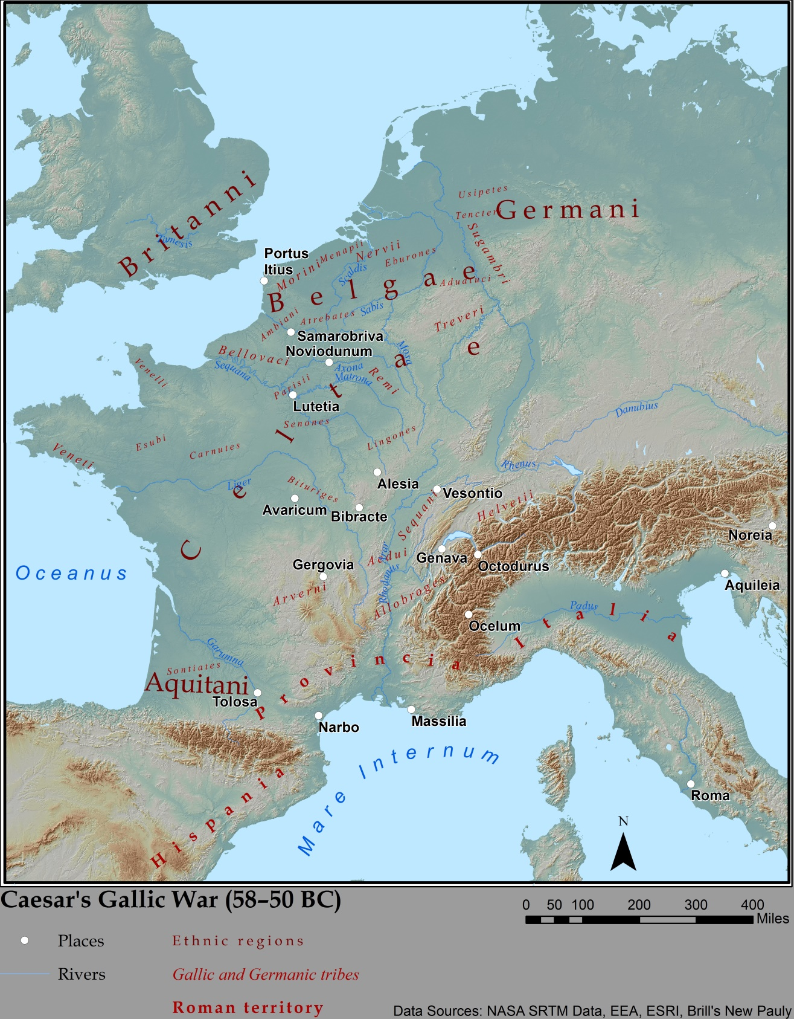
Gaul
“All Gaul is divided into three parts, one of which the Belgae inhabit, the Aquitani another, those who in their own language are called Celts, in ours Gauls, the third.”
- Julius Caesar, Gallic War 1.1
Aedui

Slide 7
Caesar as Consul
Consul in 59 BCE with Marcus Calpurnius Bibulus, a staunch optimatis
But Bibulus eventually refused to leave his house and began issuing decrees based on astrology
Passed Pompey’s land bill using violence
Granted Cisalpine Gaul as his province for three years!

Slide 8
Caesar in Gaul
c. 58-50 BCE

Slide 9
Caesar’s Justification
“The causes of their conspiracy, it was said, were as follows. In the first place, they feared that when all Gaul was pacified they might themselves be brought face to face with a Roman army; in the second, they were being stirred up by certain of the Gauls, who had either been unwilling that the Germans should stay longer in Gaul, and were now no less distressed that a Roman army should winter and establish itself in Gaul, or who for sheer fickleness and inconsistency were set upon a change of rule; in certain cases, too, the agitation was due to the fact that in Gaul the most powerful chiefs, and such as had the means to hire men, commonly endeavored to make themselves kings, and this they could not readily do under our empire.”
- Julius Caesar, Gallic Wars 2.1

Slide 10
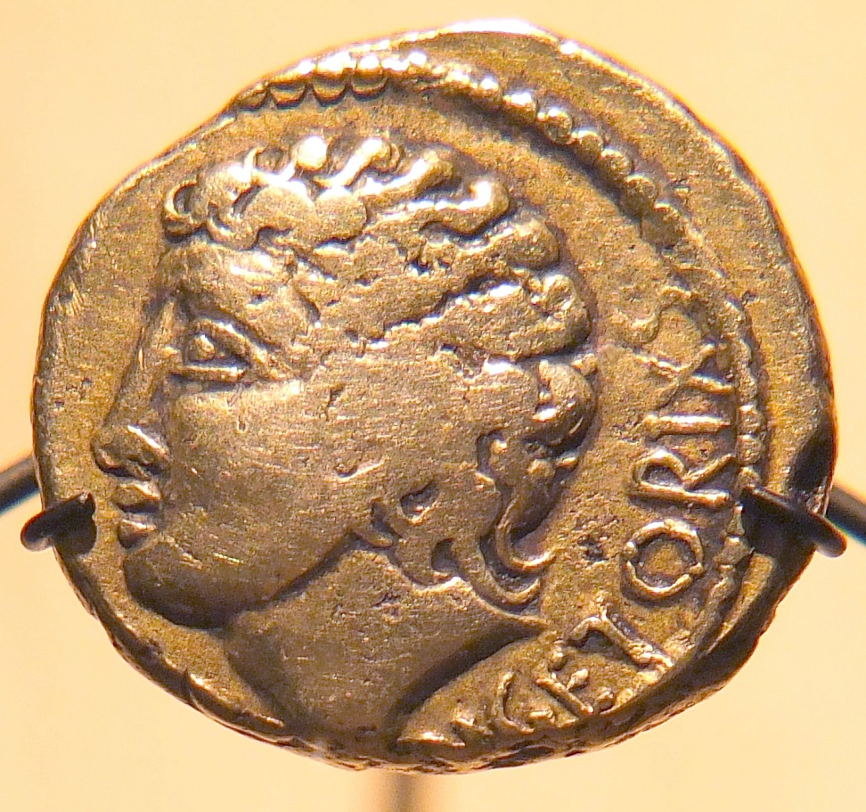
Vercingetorix
Aristocrat of the Arveni, living in central Gaul
Made himself king of the Arveni in 52 BCE (and minting coins)
Conquered neighboring Gauls
Besieged by Caesar in Alesia and eventually forced to surrender
Spent six years in captivity before his execution

Slide 11
Spoils of War
“When he had put all Pompey’s friends under obligation, as well as the greater part of the senate, through loans made without interest or at a low rate, he lavished gifts on men of all other classes, both those whom he invited to accept his bounty and those who applied to him unasked, including even freedman and slaves who were special favorites of their masters or patrons. In short, he was the sole and ever ready help of all who were in legal difficulties or in debt and of young spendthrifts, excepting only those whose burden of guilt or poverty was so heavy, or who were so given up to riotous living, that even he could not save them; and to these he declared in the plainest terms that what was needed was a civil war.”
- Suetonius, Caesar 27.1-2

Slide 12
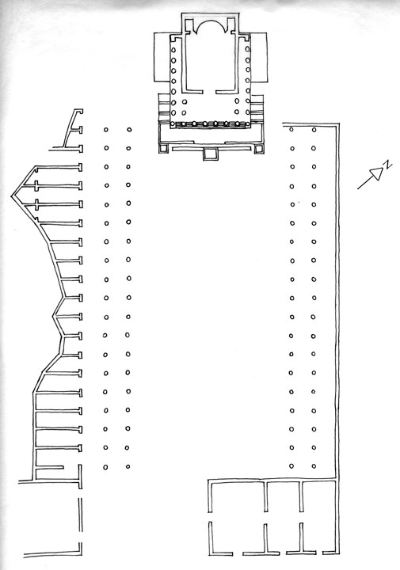
Forum Iulium
*
Caesar used spoils from the Gallic War to buy expensive plots of land near the old forum
Built a new forum: the Forum Iulium
Featured a temple of Venus Genetrix (‘Venus the Ancestor’)
Construction began in 54 BCE; dedicated in 46 BCE; completed under Augustus

Slide 13
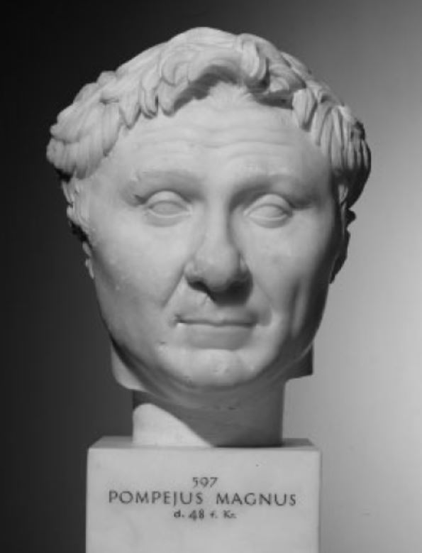
Pompey and the Senate
Sole consul in 52
Introduced a law mandating a five year gap between a consulship and governing a province
Reassigned two of Caesar’s legions from Gaul to the east
Introduced a law requires candidates for consul to stand in person

Slide 14
Cicero’s Assessment
“The possibilities are as follows: (1) Caesar’s candidature may be admitted while he still retains his army either by favor of the senate or of the tribunes. (2) Caesar may be persuaded to hand over his province and army and so become consul. (3) If he be not so persuaded, elections may be held without admission of his candidature, he not obstructing, and meanwhile retaining his province. (4) Should he obstruct this by means of tribunes but not resort to violence, there will be an interregnum. (5) If he brings up his army because his candidature is not accepted we must fight him.”
- Cicero, Letters to Atticus 7.9.2 (50 BCE)
*

Slide 15
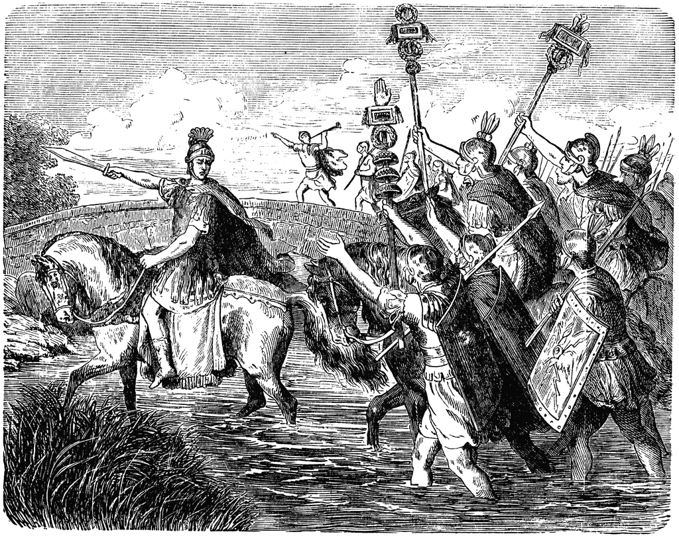
“The die is cast” (49 bce)

Slide 16
Picking Sides
“I don’t suppose it escapes you that, when parties clash in a community, it behooves a man to take the more respectable side so long as the struggle is political and not by force of arms; but if it comes to actual fighting he should choose the stronger, and reckon the safer course the better. In the present struggle Gnaeus Pompey will evidently have with him the senate the people who sit on juries, whereas all who live in present fear and small hope for the future will rally to Caesar. His army is incomparably superior. To be sure there is time enough to consider their respective resources and choose one’s side.”
- Marcus Caelius, writing to Cicero (Letters to Friends 8.14.3)

Slide 17
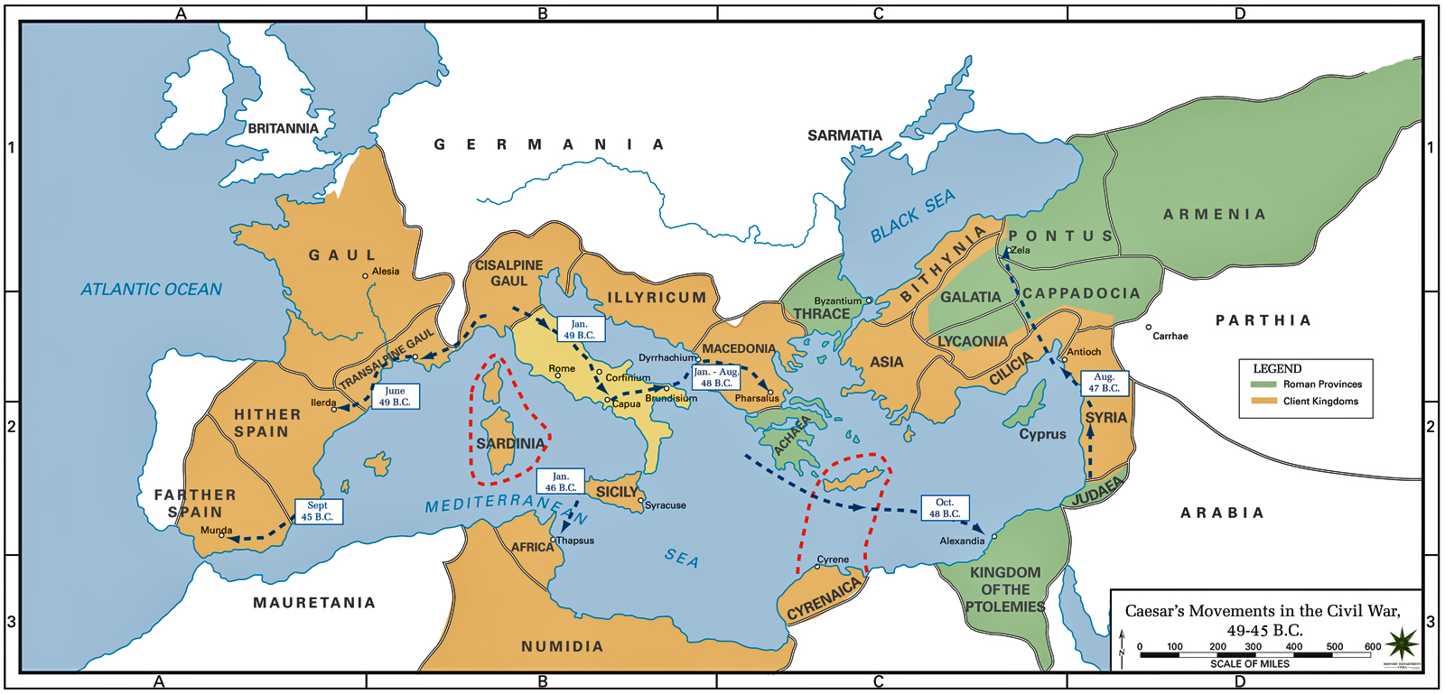
Civil War

Slide 18
Consular Elections in 48 bce
Caesar appointed dictator by the praetor Marcus Aemilius Lepidus in order to hold consular elections
Elected consul with Publius Servilius Isauricus

Slide 19
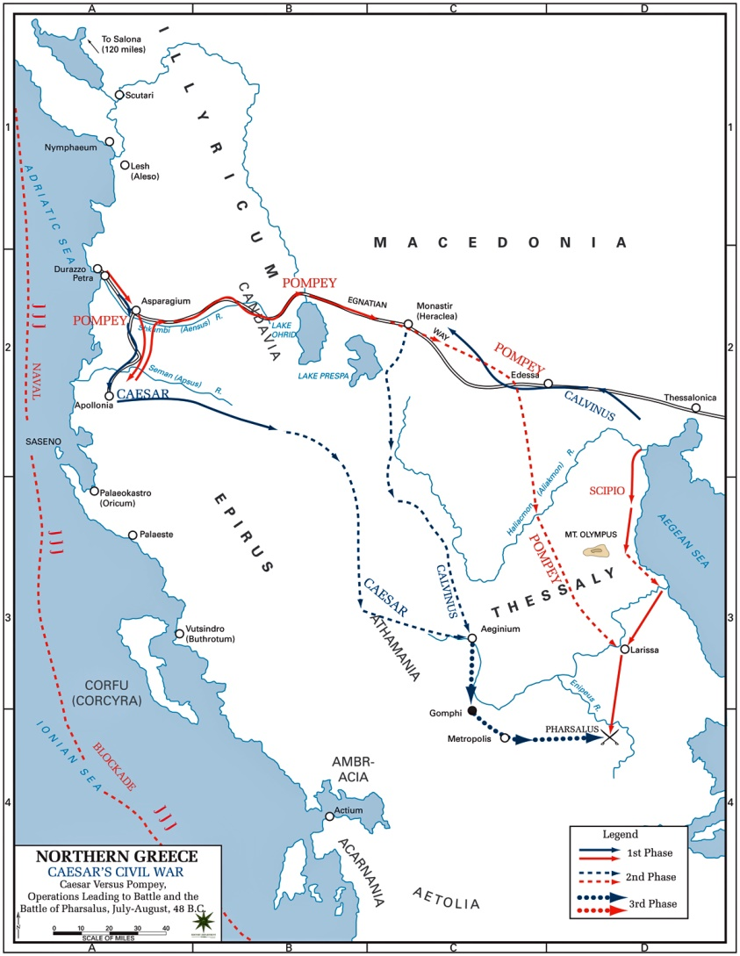
Pharsalus
Caesar crossed the Adriatic to the Dalmatian coast
Blockaded the port of Dyrrhachium, Pompey’s main port
But Pompey broke the blockade and Caesar had to march inland to Thessaly
Pompey followed, and attacked Caesar at Pharsalus
Caesar’s Gallic War veterans defeated Pompey’s forces, despite being outnumbered

Slide 20
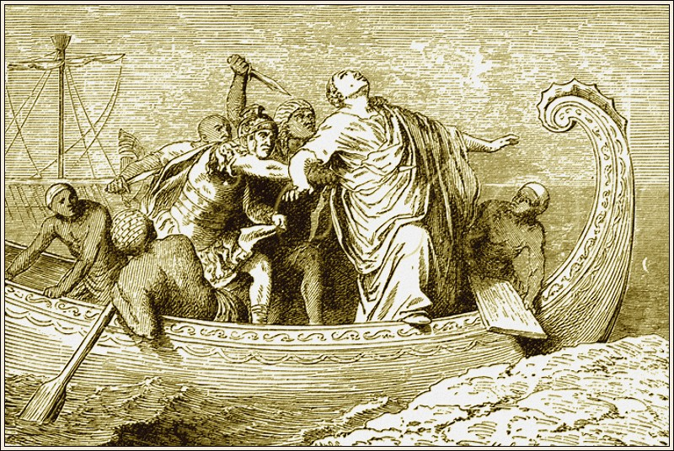
The Death of Pompey (48 bce)

Slide 21
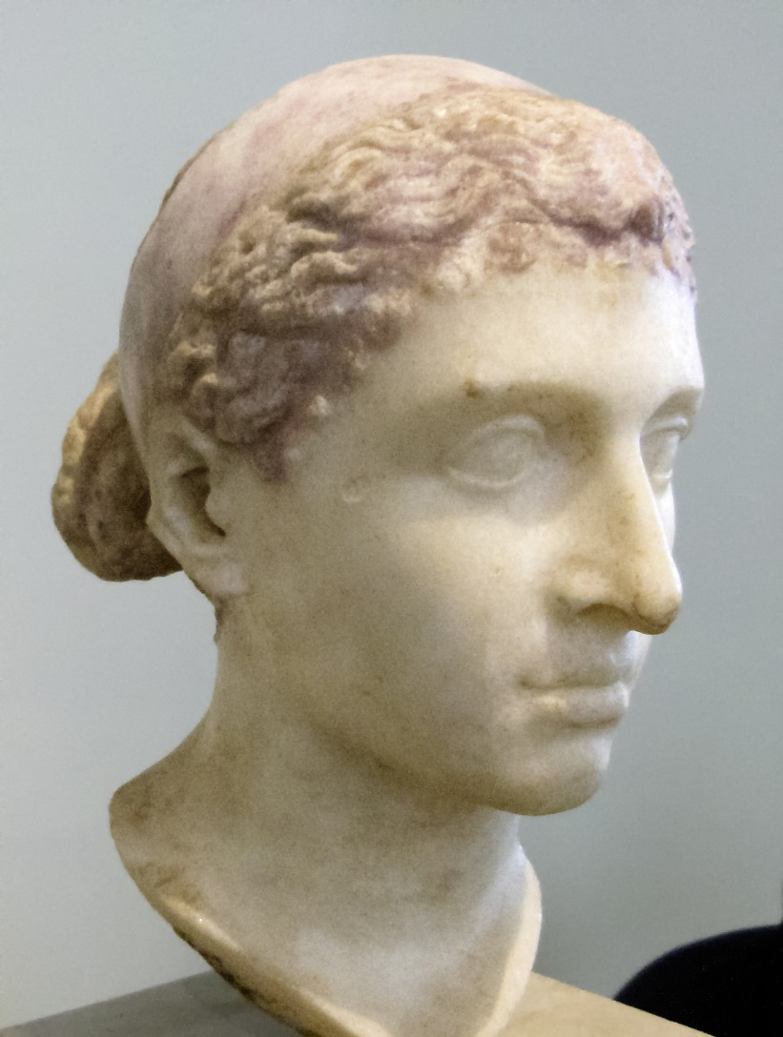
Caesar in Egypt
Arrived in late 48 BCE
Succession dispute between Ptolemy XIII (who murdered Pompey) and Cleopatra VII, his sister
Caesar sided with Cleopatra and appointed her Queen after the death of Ptolemy
Had a son, the future Ptolemy XV (‘Caesarion’)

Slide 22
Civil War (cont.)
Veni, vidi, vici
“I came, I saw, I conquered.”

Slide 23
The Death of Cato (46 bce)
“For if I were willing to be saved by the grace of Caesar, I ought to go to him in person and see him alone; but I am unwilling to be under obligation to the tyrant for his illegal acts. And he acts illegally in saving, as if their master, those over whom he has no right at all to be the lord.”
- Plutarch, Cato the Younger 66.2

Slide 24
Caesar’s New Powers
After 48 BCE:
Granted the power to declare war or make peace
Also the right to hold the consulship for five consecutive years
After 46 BCE:
Dictatorship for ten years
Responsible for elections
Supervision of public morals
After 45 BCE:
Named ‘father of the fatherland’
Birthday made a public holiday
Month of July named for him

Slide 25
Caesar’s Entourage
“But when he arrived at Philippus’ place on the evening of 18 December, the house was so thronged by the soldiers that there was hardly a spare room for Caesar himself to dine in. Two thousands men, no less…Camp was pitched in the open and a guard placed on the house. On the 19th Caesar stayed with Philippus until 1 o’clock admitting nobody – at accounts, I believe, with Balbus…His entourage moreover were lavishly entertained in three other dining rooms. The humbler freedmen and slaves had all they wanted – the smarter ones I entertained in style.”
- Cicero, Letters to Atticus 13.52

Slide 26
Caesar’s Mode of Rule
“When I am in Rome, up and down the Forum, decrees are drawn up at the residence of your admirer, Caesar. What is more, when it happens to occur to him, I am put down as present at drafting, and I hear of some decree, allegedly passed on my motion, reaching Armenia and Syria before I know that there has been so much of a mention of the matter concerned. You must not think I am joking. Let me tell you that letters have been brought to me before today from monarchs at the other end of the earth, thanking me for my motion to give them the royal title, when I for my part was unaware of their very existence, let alone of their elevation to royalty.”
- Cicero, Letters to Friends 9.15 (46 BCE)
*

Slide 27
Ban on Long Commands
“Since it was by ruling the Gauls for many years in succession that he himself had conceived a greater desire for dominion and had increased the equipment of his force, he limited by law the term of propraetors to one year that of proconsuls to two consecutive years, and enacted that no one whatever should be allowed to hold any command for a longer time.”
- Cassius Dio 43.25.3

Slide 28
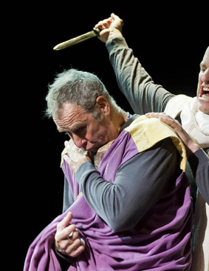
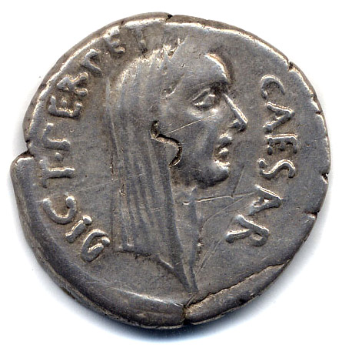
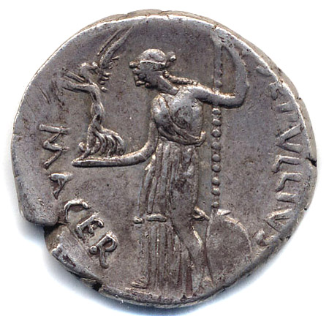
Dictator for Life (44 bce)
*
Silver denarius, Rome, Italy, c. 44 BCE; obv.: veiled head of Caesar r.; legend: CAESAR DICT PERPETVO; rev.: Venus standing l. holding scepter and Victory; legend: P SEPVLLIVS MACER

Slide 29
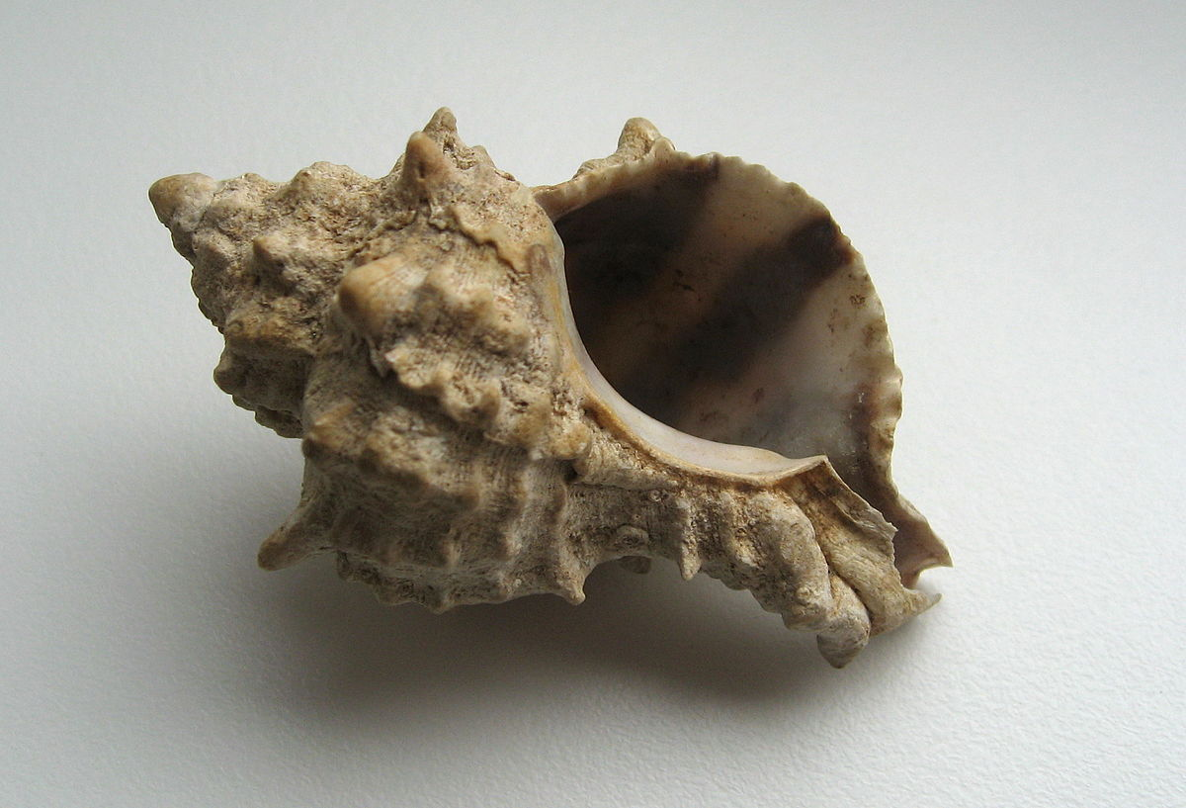
Purple
Produced from shells in the eastern Mediterranean, especially Tyre
10,000 shellfish were required to produce one gram of dye
In 301 CE, one pound of purple wool cost between 12,000 and 50,000 denarii
And one pound of purple silk cost 150,000 denarii!

Slide 30
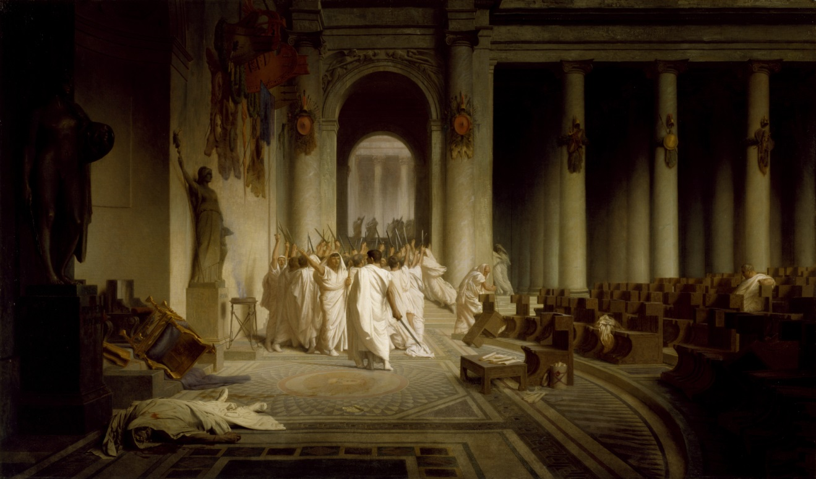
The Death of Caesar Ides of March, 44 bce

Slide 31
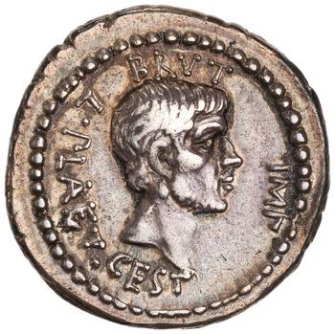
Brutus
c. 85-42 BCE
Claimed descent from Lucius Iunius Brutus; nephew of Cato the Younger
Served under Pompey during the Civil War
Pardoned by Caesar after Pharsalus
Joined the conspiracy against Caesar in February, 44 BCE
*
Silver denarius, Greece(?), c. 43-42 BCE; obv.: head of Brutus r.; legend: BRVT[us] IMP[erator] L. PLAET[us] CEST[us]; rev.: freedman’s cap between daggers; legend: EID MAR (the ides of March)

Slide 32
The Post-Caesar Dilemma
If Caesar was a tyrant, then all his decrees were illegal
Thus invalidating all magistracies appointed by him, including those held by the murders
So the Roman government would disappear
If he was not, then the murders were common criminals and had to be punished
So Cicero proposed that Caesar’s decrees be validated but that the murderers be pardoned

Slide 33
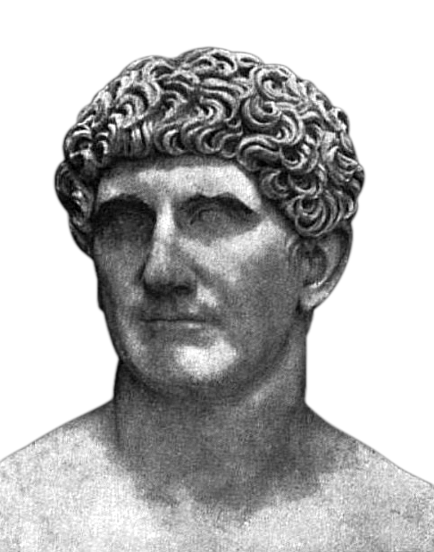
Mark Antony
Marcus Antonius
c. 83-30 BCE
Military career, including in Gaul under Caesar
Quaestor in 52, augur in 50, tribune of the plebs in 49
Supported Caesar’s invasion of Italy and served as his deputy
Made consul in 44
Delivered a funeral oration for Caesar that roused the people of Rome against the assassins

Slide 34

Octavian
63 BCE-14 CE
Born Gaius Octavius
Grand nephew of Julius Caesar
Fought with Caesar against Sextus Pompey in Spain
Upon Caesar’s death he accepted inheritance of his will, and therefore the onus to avenge his killing
And his name
Hence ‘Gaius Julius Caesar Octavianus’

Slide 35

Antony vs Octavian

Slide 36
The Second Triumvirate
Marcus Aemilius Lepidus

Slide 37
Key Terms
Julius Caesar
Gaul
Vercingetorix
Pharsalus
Cleopatra
Marcus Iunius Brutus
Mark Antony
Octavian

